Slide 1
Ìkíni láàárín irọ̀

Slide 2
Performance Objective
By the end of this lesson, you will be able to greet a peer of yours (classmate, friend, colleague, etc) by the time of day.

Slide 3
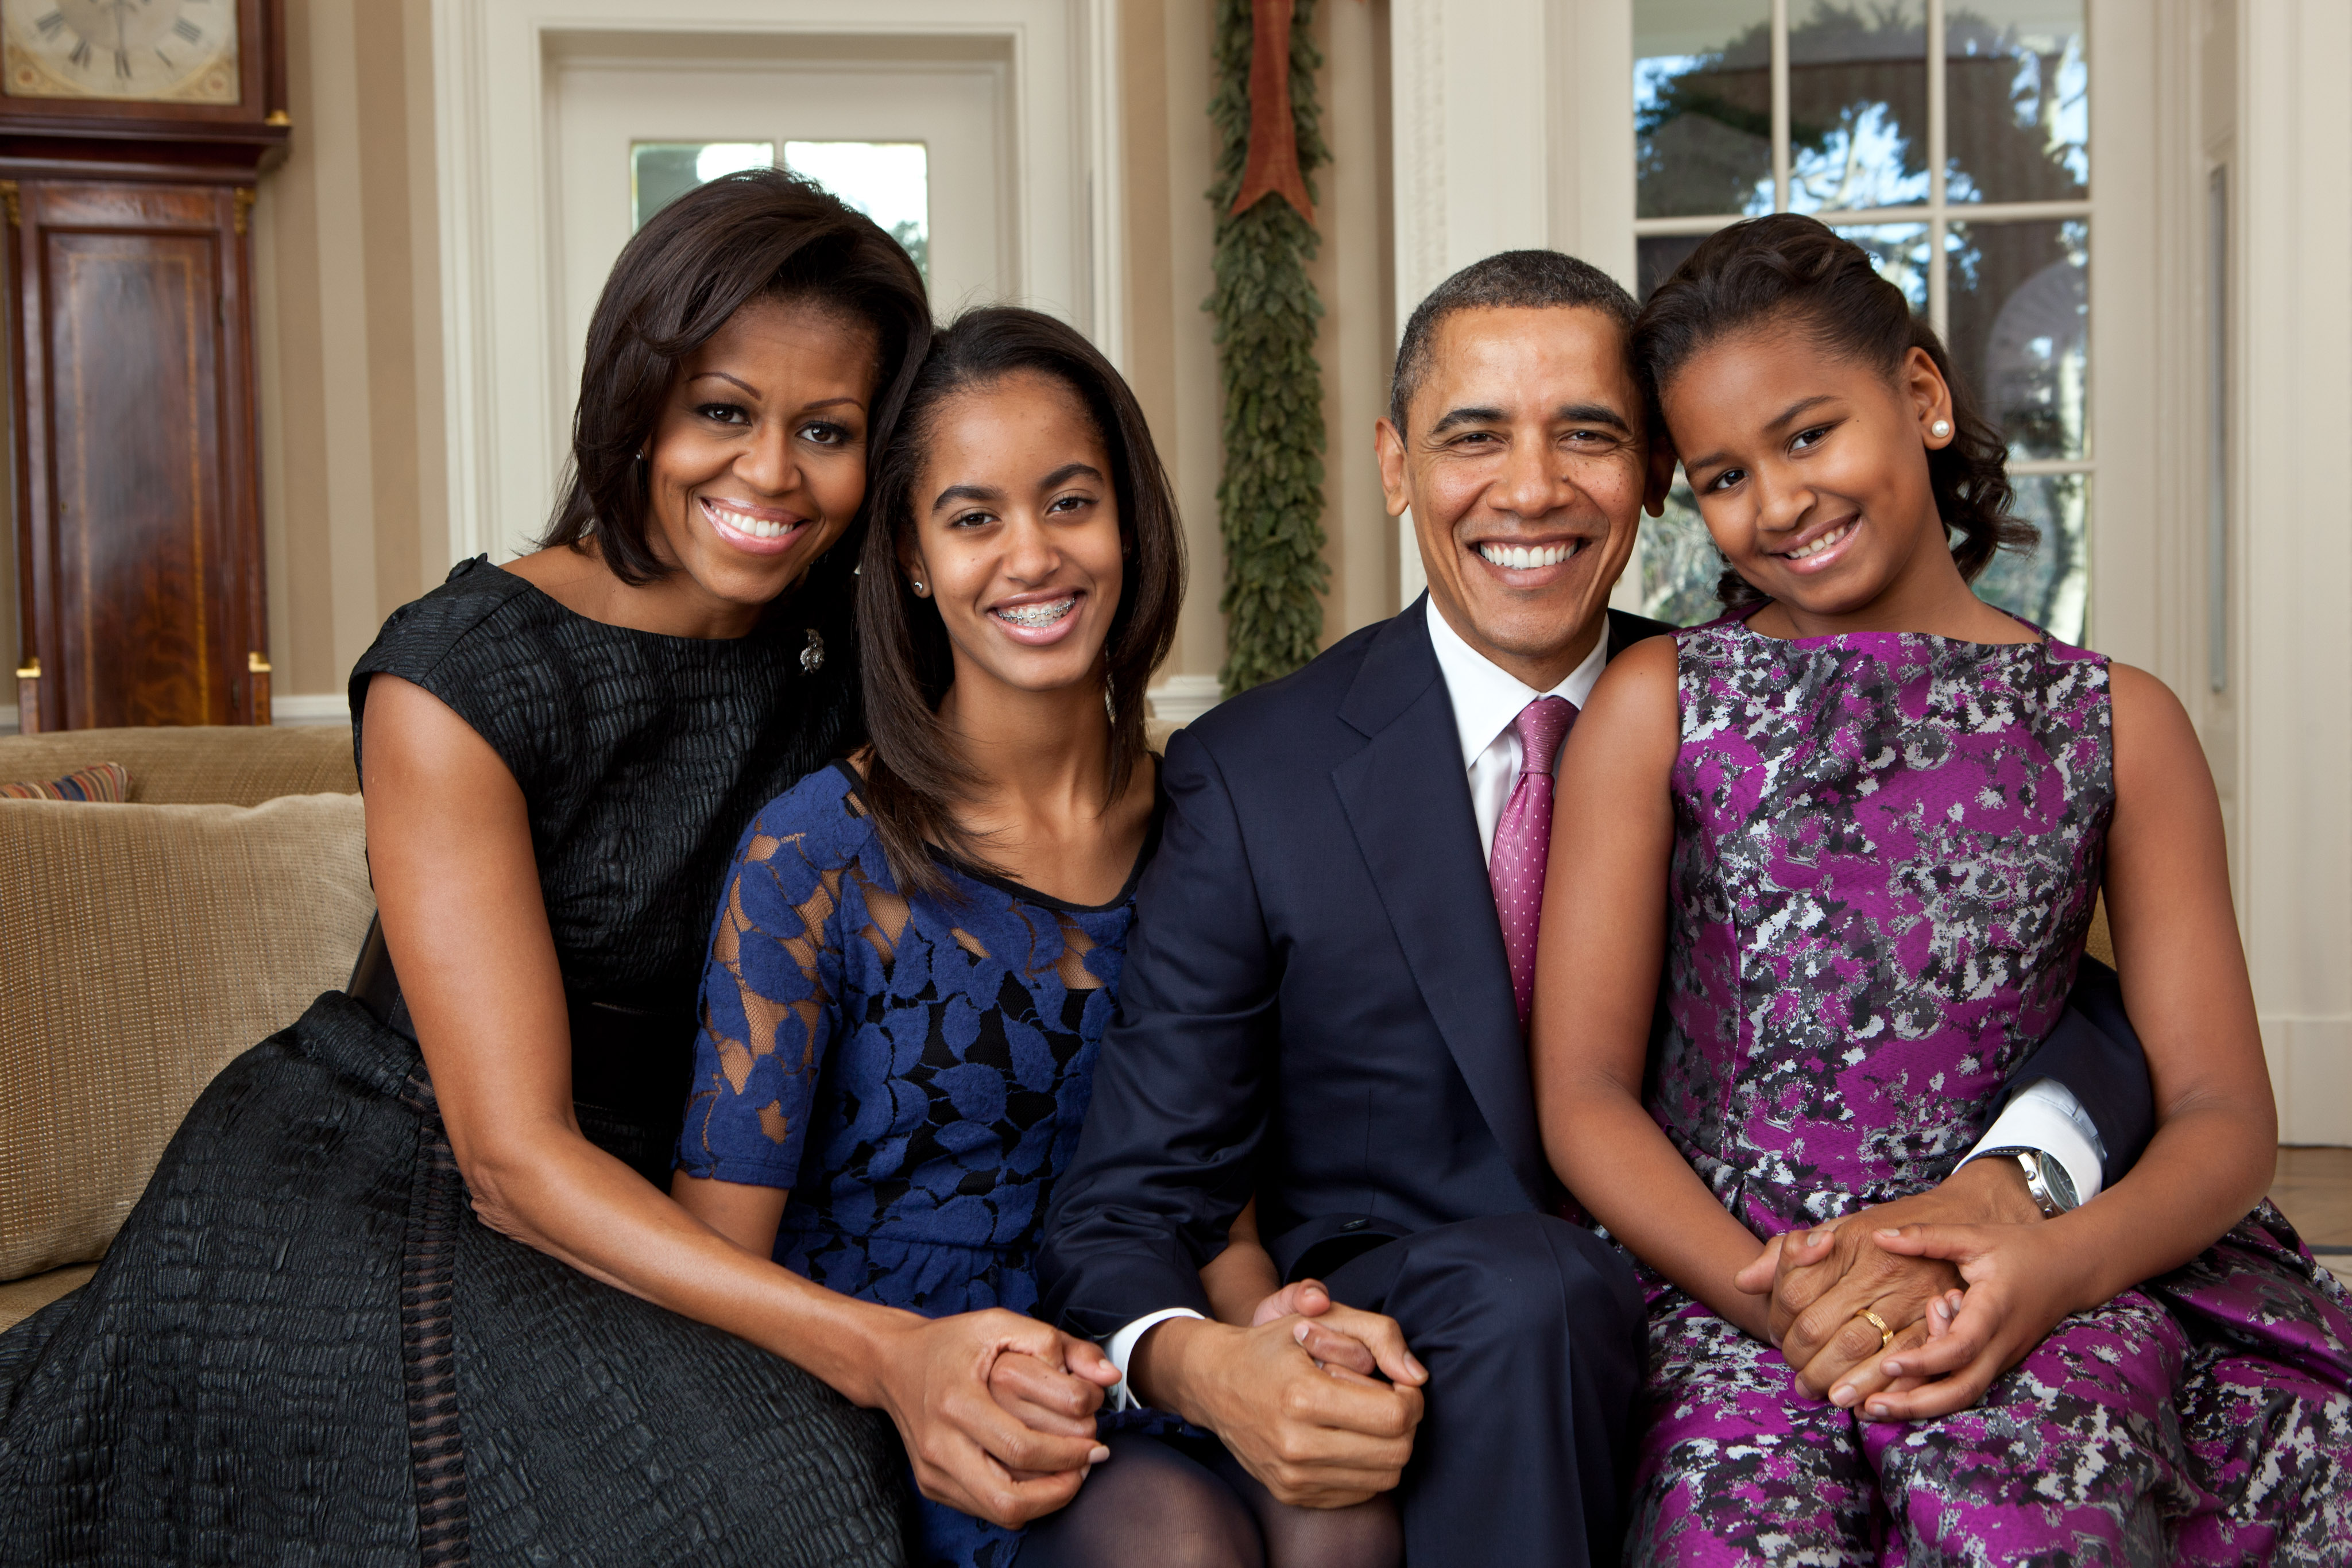
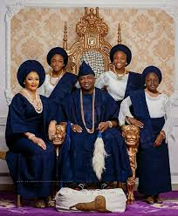
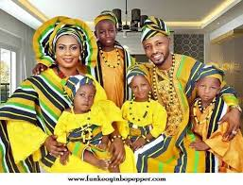
Ilé (family)

Slide 4
Bàbá

Slide 5
Màmá

Slide 6
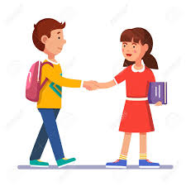
Peer Greetings
Báwo ni, Ruth?
Dáadáa ni, Mwita

Slide 7
Ilé ńkọ́?
Ó wà

Slide 8
Bàbá ńkọ́?
Wọ́n wà

Slide 9
Màmá ńkọ́?
Wọ́n wà

Slide 10

Ó dàbọ
Ó dàbọ

Slide 11
dialogue
Mwita: Báwo ni Ruth!
Ruth: Dáadáa ni Mwita!
Mwita: Bàbá ńkọ́?
Ruth: Wọ́n wà
Mwita: Màmá ńkọ́?
Ruth: Wọ́n wà!
Mwita: Ilé ńkọ́?
Ruth: Ó wà!
Mwita: Ó dàbọ!
Ruth: Ó dàbọ!

Slide 12
activity
You just met Mwita who is your colleague at work. Greet each other.

